Slide 1
Topic 2
Introduction to Computers, Programs, and JavaScript

Slide 2
Objectives
To distinguish the terms API, IDE, and JDK.
To write a simple JavaScript program.
To create, compile, and run JavaScript programs.
To know the basic syntax of a JavaScript program.
To display output in a dialog box.

Slide 3
Programs
Computer program ( known as Software )
  Instructions to computer.
  Written using programming languages.
Examples of programming languages
  Machine language.
  Assembly language
  High-level language

Slide 4
Examples of
Programming Languages
  Machine language.
  are in the form of binary code
  are different for different type of computers
  the programs are highly difficult for human to read and modify
  Eg: 1101101010011010

Slide 5
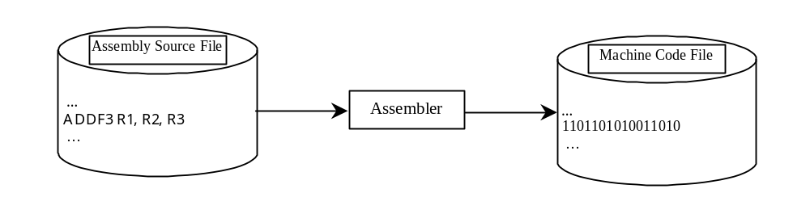
Examples of programming Languages
  Assembly language (low level language)
  were developed to make programming easy
  the computer cannot understand assembly language
  a program called assembler is used to convert assembly language programs into machine code
  Eg: ADDR R1,R2,R3

Slide 6
Examples of programming Languages
  High-level language
  is English-like and easy to learn and program.
Eg.: the following is a high-level languages statement that
computes the area of a circle with radius 5:
area = 5 * 5 * 3.141

Slide 7
Compiling Source Code
A program written in a high-level language is called a source program (or source code).
A computer by itself cannot understand a source program.
Therefore, there is a small computer program called an ‘interpreter’ or a ‘compiler’ (2 different things) that helps translate those source programs into the instructions that can be understood by computer devices.
For JavaScript, there is a JavaScript Engine that acts as the interpreter. Most modern web browsers have this engine.
In addition, node.js is a JavaScript run-time environment, which uses Chrome V8 engine that acts as an interpreter, compiler and optimizer. This allows programmers to develop server & desktop applications.

Slide 8
Why JavaScript?
JavaScript, although it was originally introduced as a scripting language for the WWW, is now a full featured, general purpose programming language.
It has low barrier to entry (easy to get started with)
Visible results can be seen with the minimum amount of code compared to other languages
JavaScript can be used to develop various type of software applications such as:
  Web Application (angularJS)
  Server applications (node.js)
  Mobile Applications for hand-held devices (Apache Cordova)
  Desktop Application (Electron, AppJS)

Slide 9

Examples of JavaScript’s Versatility
Web Application

Slide 10
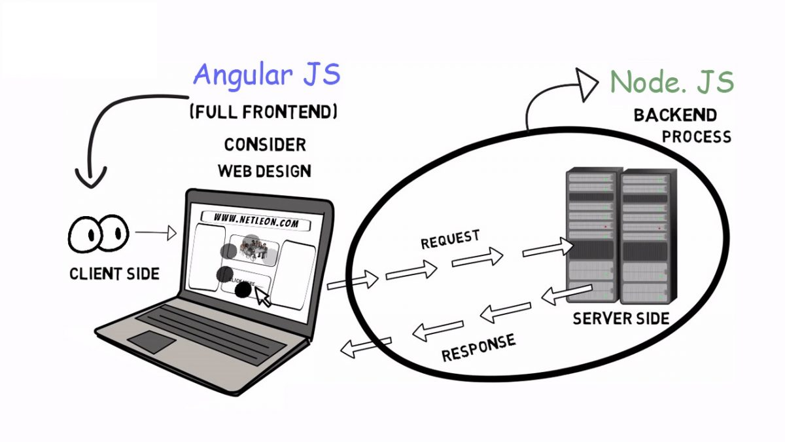
Examples of Java’s Versatility
Server Application

Slide 11
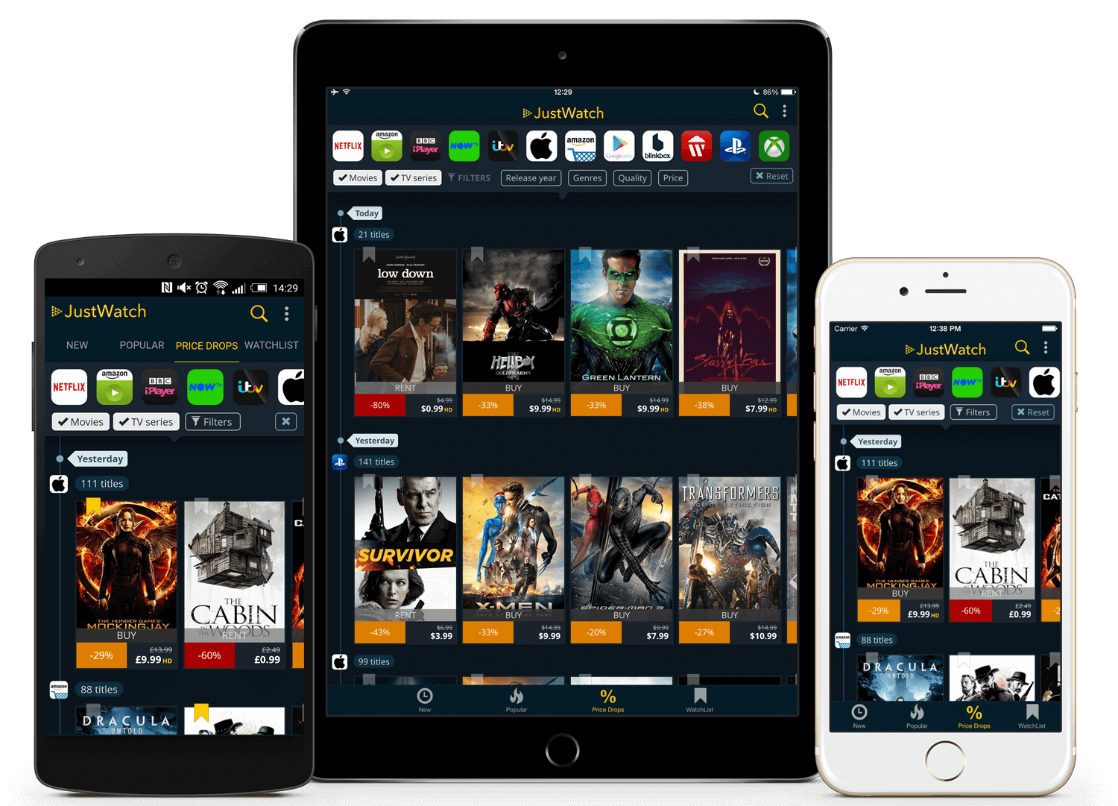
Examples of Java’s Versatility
Mobile Application: JustWatch

Slide 12
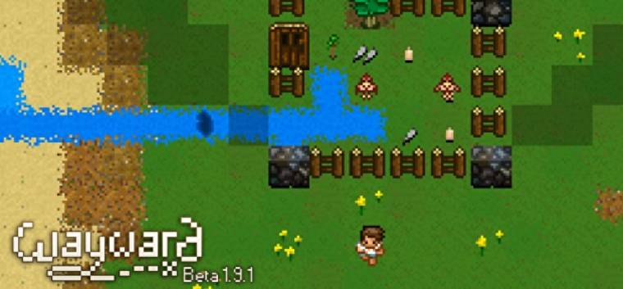
Examples of Java’s Versatility
Desktop Application: Wayward Game (https://www.wayward.com)

Slide 13
node.js
node.js is an open-source, cross-platform JavaScript run-time environment, built on Chrome's V8 JavaScript Engine, that executes JavaScript code outside of a browser.
A JavaScript Engine is simply a program (an interpreter) that executes JavaScript code. It helps to translate JavaScript source code into bytecode i.e. something that can be understood by computer devices.
A JavaScript run-time environment provides the built-in libraries/objects that are available to the program or needed by the program at runtime (during execution).

Slide 14
node.js
Analogy
Imagine you are asking a robot to help you clean your house.
A JavaScript source code would be the instructions you give to the robot in your own language (e.g. English, Chinese, Malay, Tamil, Hindi) on how you want your house to be cleaned.
A JavaScript Engine would be the robot which can understand your language and is able to act on it.
A JavaScript run-time environment would be the cleaning tools such as a broom, mop, vacuum cleaner, etc that are used by the robot to complete the cleaning tasks for you.

Slide 15
Integrated Development Environment (IDE) Tools
An IDE is a software that consolidates all tools required to write, test and debug computer program.
These are some of the most popular free development tools (IDE) for JavaScript (and also other languages such as Python, HTML, CSS):
Microsoft Visual Studio Code
Atom by Github
Komodo IDE

Slide 16
A Simple JavaScript Program
Example 1: Guess what does the program do?
name = "John Tan";
console.log("Hello " + name);

Slide 17
A Simple JavaScript Program
Example 1: Guess what does the program do?
name = "John Tan";
console.log("Hello " + name);
The first statement is executed. This statement declares a variable called name and assign “John Tan” to it.

Slide 18

A Simple JavaScript Program
Example 1: Guess what does the program do?
name = "John Tan";
console.log("Hello " + name);
The second statement is now executed. This displays “Hello John Tan” on the debug console as shown below.
print a message to the console

Slide 19
Exercises
Download Practical 2 from the Blackboard.
Complete the installation of node.js and Visual Studio Code if you have not done so.
Now try Practical 2 Qn 4, to create, compile and run the program that displays your initials.

Slide 20
A Simple JavaScript Program
Comments
//This program prints Welcome to FOP!
console.log("Welcome to FOP!");
Reserved words
A statement
Notes:
This is a sample of JavaScript. We will cover more in details in the subsequent lessons.

Slide 21
Comments
Make programs more readable and easier to work on.
Ignored by compiler and does not affect program output.
Single line comment:
// some text, are preceded by two slashes (//) in a line
Multi-line comment:
  /*
  some text, are enclosed between /* and */ in one or multiple lines
  */
When the compiler sees //, it ignores all text after // in the same line.
When the compiler sees /*, it scans for the next */ and ignores any text between /* and */.

Slide 22
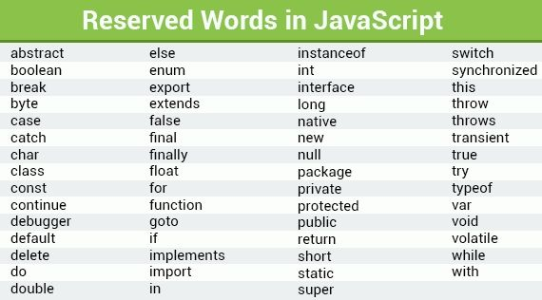
Reserved Words
Reserved words or keywords (some are shown in the table below) have a specific meaning to the compiler and cannot be used for other purposes.
Reserved words are the words that have already been taken by the JavaScript Engine (e.g. console is a prebuilt class and log is a built-in function). Therefore, you are not allowed to use any of the words to name your variables/functions/classes.

Slide 23
Statements
A statement represents an action or a sequence of actions.
Unlike many other popular programming languages such as Java or C, it is optional for you to choose whether or not to end each statement with a semi-colon (;).
However, it is a good practice to use semi-colon to end each of your statements with a semi-colon.
E.g.: The following statement prints
Welcome to JavaScript!
console.log("Welcome to JavaScript!");

Slide 24
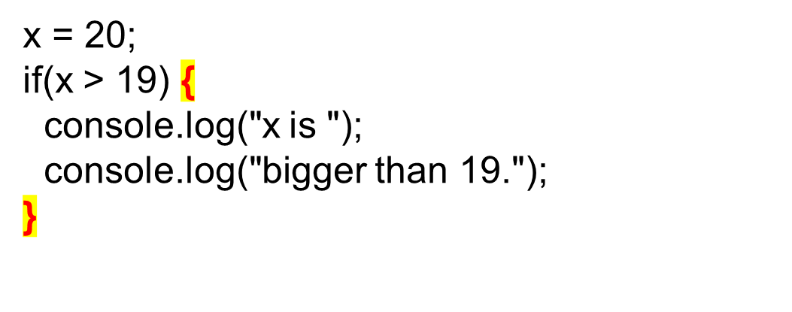
Blocks
A pair of curly braces { … } in a program forms a block that groups components of a program.
Blocks can be nested. One block can be placed within another.

Slide 25
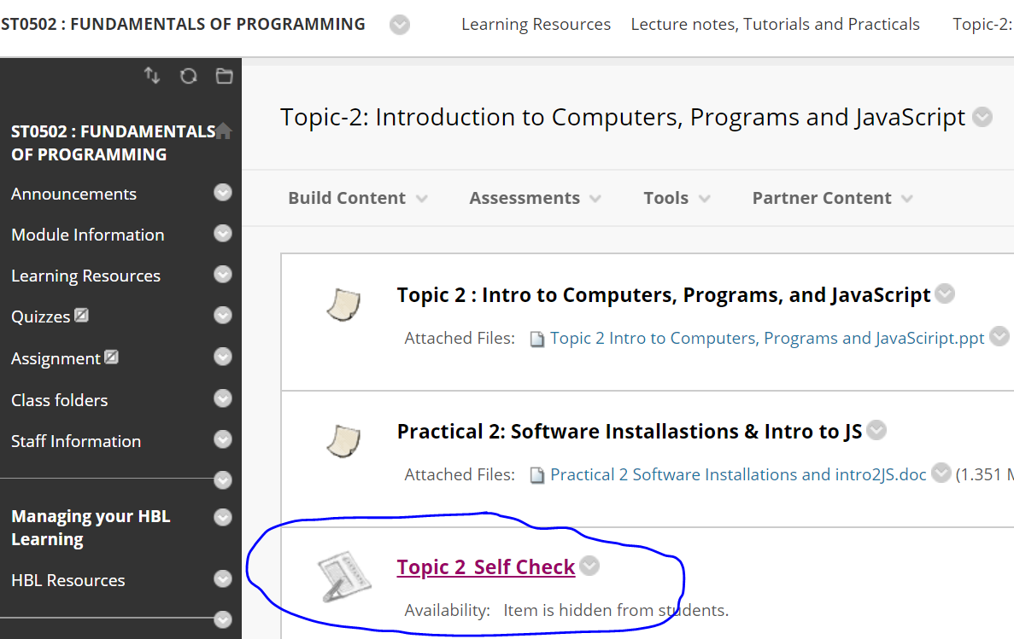
Topic 2 : Self_Check Quiz
Please complete Topic 2 Self-Check quiz.
It will be graded under CA9 Assessment.
Only 5 attempts are allowed.

Slide 26
Summary of Topic 2
To distinguish the terms API, IDE, and JDK.
To write a simple JavaScript program.
To create, compile, and run JavaScript programs.
To know the basic syntax of a JavaScript program.
To display output in a dialog box.

